Slide 1
Week-3 Operating System Overview
Operating Systems: Internals and Design Principles

Slide 2
Operating Systems: Internals and Design Principles
Operating systems are those programs that interface the machine with
the applications programs. The main function of these systems is to
dynamically allocate the shared system resources to the executing
programs. As such, research in this area is clearly concerned with
the management and scheduling of memory, processes, and other
devices. But the interface with adjacent levels continues to shift with
time. Functions that were originally part of the operating system have
migrated to the hardware. On the other side, programmed functions
extraneous to the problems being solved by the application programs
are included in the operating system.
—WHAT CAN BE AUTOMATED?: THE COMPUTER SCIENCE AND
ENGINEERING RESEARCH STUDY,
MIT Press, 1980

Slide 3
Operating System
A program that controls the execution of application programs
An interface between applications and hardware
Main objectives of an OS:
Convenience
Efficiency
Ability to evolve

Slide 4

Operating System Services
Program development
Program execution
Access I/O devices
Controlled access to files
System access
Error detection and response
Accounting

Slide 5
Key Interfaces
Instruction set architecture (ISA)
Application binary interface (ABI)
Application programming interface (API)

Slide 6
The Role of an OS
A computer is a set of resources for the movement, storage, and processing of data
The OS is responsible for managing these resources

Slide 7
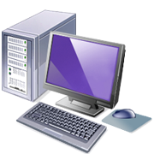
Operating System as Software
Functions in the same way as ordinary computer software
Program, or suite of programs, executed by the processor
Frequently relinquishes control and must depend on the processor to allow it to regain control

Slide 8
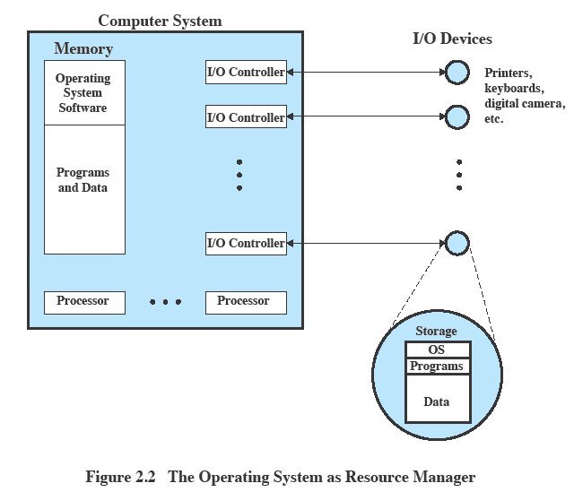
Operating System as Resource Manager

Slide 9
Evolution of Operating Systems
A major OS will evolve over time for a number of reasons:
Hardware upgrades
New types of hardware
New services
Fixes

Slide 10
Evolution of Operating Systems
Stages include:
Serial Processing
Simple Batch Systems
Multiprogrammed Batch Systems
Time Sharing Systems

Slide 11
Serial Processing
Earliest Computers:
Problems:
Scheduling:
most installations used a hardcopy sign-up sheet to reserve computer time
time allocations could run short or long, resulting in wasted computer time
Setup time
a considerable amount of time was spent just on setting up the program to run
No operating system
programmers interacted directly with the computer hardware
Computers ran from a console with display lights, toggle switches, some form of input device, and a printer
Users have access to the computer in “series”

Slide 12
Simple Batch Systems
Early computers were very expensive
important to maximize processor utilization
Monitor
user no longer has direct access to processor
job is submitted to computer operator who batches them together and places them on an input device
program branches back to the monitor when finished

Slide 13
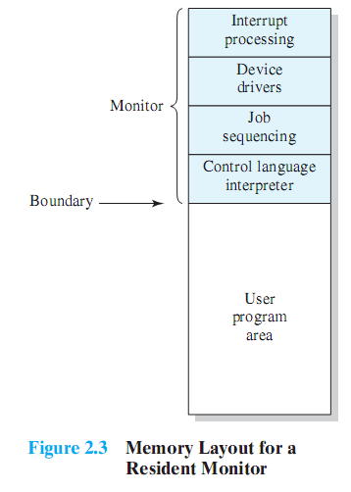
Monitor Point of View
Monitor controls the sequence of events
Resident Monitor is software always in memory
Monitor reads in job and gives control
Job returns control to monitor

Slide 14
Processor Point of View
Processor executes instruction from the memory containing the monitor
Executes the instructions in the user program until it encounters an ending or error condition
“control is passed to a job” means processor is fetching and executing instructions in a user program
“control is returned to the monitor” means that the processor is fetching and executing instructions from the monitor program

Slide 15
Job Control Language (JCL)
Special type of programming language used to provide instructions to the monitor
what compiler to use
what data to use

Slide 16

Desirable Hardware Features
Memory protection for monitor
while the user program is executing, it must not alter the memory area containing the monitor
Timer
prevents a job from monopolizing the system
Privileged instructions
can only be executed by the monitor
Interrupts
gives OS more flexibility in controlling user programs

Slide 17
Modes of Operation
User Mode
user program executes in user mode
certain areas of memory are protected from user access
certain instructions may not be executed
Kernel Mode
monitor executes in kernel mode
privileged instructions may be executed
protected areas of memory may be accessed

Slide 18
Simple Batch System Overhead
Processor time alternates between execution of user programs and execution of the monitor
Sacrifices:
some main memory is now given over to the monitor
some processor time is consumed by the monitor
Despite overhead, the simple batch system improves utilization of the computer

Slide 19
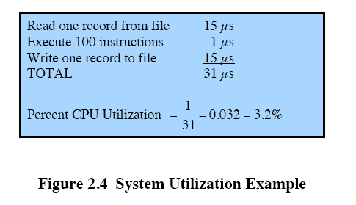
Multiprogrammed Batch Systems
Processor is often idle
even with automatic job sequencing
I/O devices are slow compared to processor

Slide 20

Uniprogramming
The processor spends a certain amount of time executing, until it reaches an I/O instruction; it must then wait until that I/O instruction concludes before proceeding

Slide 21
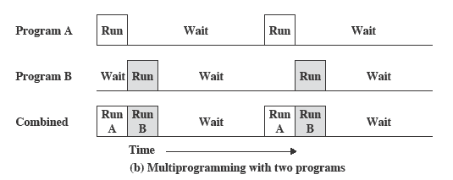
Multiprogramming
There must be enough memory to hold the OS (resident monitor) and one user program
When one job needs to wait for I/O, the processor can switch to the other job, which is likely not waiting for I/O

Slide 22
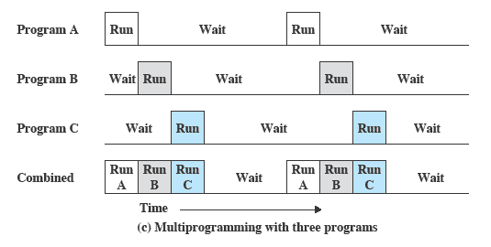
Multiprogramming
Multiprogramming
also known as multitasking
memory is expanded to hold three, four, or more programs and switch among all of them

Slide 23
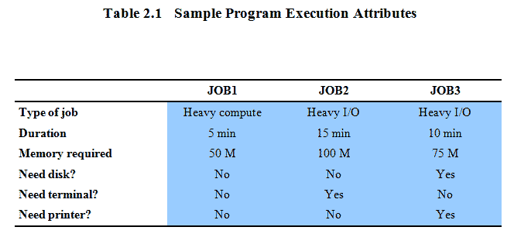
Multiprogramming Example

Slide 24
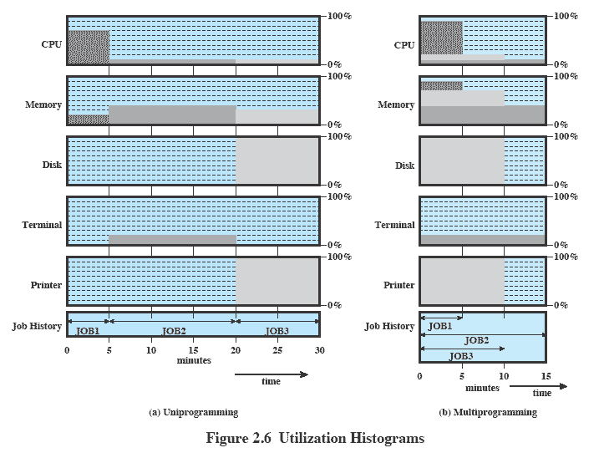
Utilization Histograms

Slide 25
Time-Sharing Systems
Can be used to handle multiple interactive jobs
Processor time is shared among multiple users
Multiple users simultaneously access the system through terminals, with the OS interleaving the execution of each user program in a short burst or quantum of computation

Slide 26
Compatible Time-Sharing Systems
CTSS
Time Slicing
System clock generates interrupts at a rate of approximately one every 0.2 seconds
At each interrupt OS regained control and could assign processor to another user
At regular time intervals the current user would be preempted and another user loaded in
Old user programs and data were written out to disk
Old user program code and data were restored in main memory when that program was next given a turn
One of the first time-sharing operating systems
Developed at MIT by a group known as Project MAC
Ran on a computer with 32,000 36-bit words of main memory, with the resident monitor consuming 5000 of that
To simplify both the monitor and memory management a program was always loaded to start at the location of the 5000th word

Slide 27
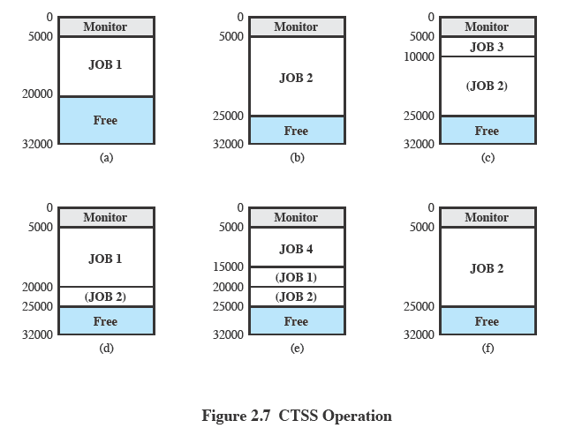
CTSS Operation

Slide 28
Major Advances
Operating Systems are among the most complex pieces of software ever developed
Major advances in development include:
Memory management
Information protection and security
Scheduling and resource management
System structure
Processes

Slide 29
Process
Fundamental to the structure of operating systems
A process can be defined as:
a program in execution
an instance of a running program
the entity that can be assigned to, and executed on, a processor
a unit of activity characterized by a single sequential thread of execution, a current state, and an associated set of system resources

Slide 30
Development of the Process
Three major lines of computer system development created problems in timing and synchronization that contributed to the development:
multiprogramming batch operation
processor is switched among the various programs residing in main memory
time sharing
be responsive to the individual user but be able to support many users simultaneously
real-time transaction systems
a number of users are entering queries or updates against a database

Slide 31

Causes of Errors
Improper synchronization
a program must wait until the data are available in a buffer
improper design of the signaling mechanism can result in loss or duplication
Nondeterminate program operation
program execution is interleaved by the processor when memory is shared
the order in which programs are scheduled may affect their outcome
Deadlocks
it is possible for two or more programs to be hung up waiting for each other
may depend on the chance timing of resource allocation and release
Failed mutual exclusion
more than one user or program attempts to make use of a shared resource at the same time
only one routine at at time allowed to perform an update against the file

Slide 32
Components of a Process
A process contains three components:
an executable program
the associated data needed by the program (variables, work space, buffers, etc.)
the execution context (or “process state”) of the program
The execution context is essential:
it is the internal data by which the OS is able to supervise and control the process
includes the contents of the various process registers
includes information such as the priority of the process and whether the process is waiting for the completion of a particular I/O event

Slide 33
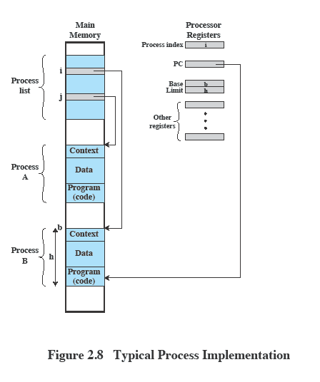
Process Management
The entire state of the process at any instant is contained in its context
New features can be designed and incorporated into the OS by expanding the context to include any new information needed to support the feature

Slide 34
Memory Management
The OS has five principal storage management responsibilities:
process isolation
long-term storage
protection and access control
support of modular programming
automatic allocation and management

Slide 35
Virtual Memory
A facility that allows programs to address memory from a logical point of view, without regard to the amount of main memory physically available
Conceived to meet the requirement of having multiple user jobs reside in main memory concurrently

Slide 36
Paging
Allows processes to be comprised of a number of fixed-size blocks, called pages
Program references a word by means of a virtual address
consists of a page number and an offset within the page
each page may be located anywhere in main memory
Provides for a dynamic mapping between the virtual address used in the program and a real (or physical) address in main memory

Slide 37
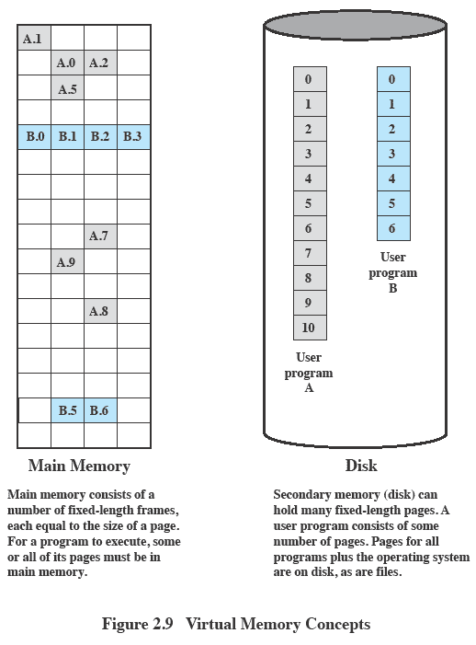
Virtual Memory

Slide 38
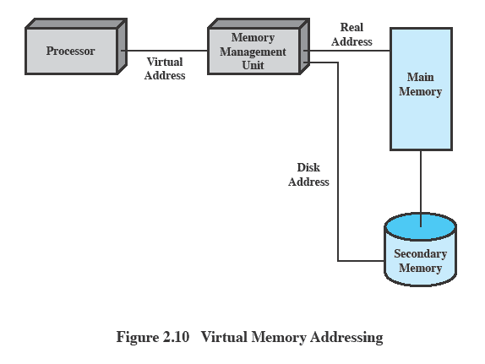
Virtual Memory Addressing

Slide 39
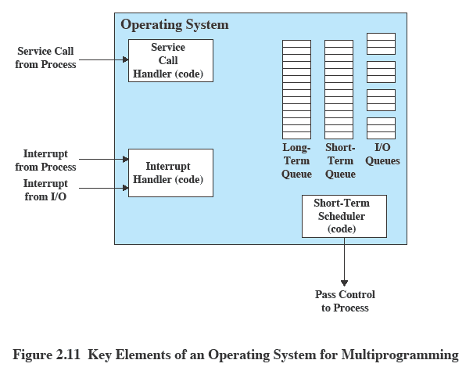
Key Elements of an Operating System

Slide 40
Different Architectural Approaches
Different approaches and design elements have been tried:
Microkernel architecture
Multithreading
Symmetric multiprocessing
Distributed operating systems
Object-oriented design
Demands on operating systems require new ways of organizing the OS

Slide 41
Microkernel Architecture
Assigns only a few essential functions to the kernel:
The approach:
address spaces
interprocess communication (IPC)
basic scheduling
simplifies implementation
provides flexibility
is well suited to a distributed environment

Slide 42
Multithreading
Technique in which a process, executing an application, is divided into threads that can run concurrently
Thread
dispatchable unit of work
includes a processor context and its own data area to enable subroutine branching
executes sequentially and is interruptible
Process
a collection of one or more threads and associated system resources
programmer has greater control over the modularity of the application and the timing of application related events

Slide 43
Virtual Machines and Virtualization
Virtualization
enables a single PC or server to simultaneously run multiple operating systems or multiple sessions of a single OS
a machine can host numerous applications, including those that run on different operating systems, on a single platform
host operating system can support a number of virtual machines (VM)
each has the characteristics of a particular OS and, in some versions of virtualization, the characteristics of a particular hardware platform

Slide 44
Virtual Machine Architecture
Process perspective:
the machine on which it executes consists of the virtual memory space assigned to the process
the processor registers it may use
the user-level machine instructions it may execute
OS system calls it may invoke for I/O
ABI defines the machine as seen by a process
Application perspective:
machine characteristics are specified by high-level language capabilities and OS system library calls
API defines the machine for an application
OS perspective:
processes share a file system and other I/O resources
system allocates real memory and I/O resources to the processes
ISA provides the interface between the system and machine

Slide 45
Multicore OS Considerations
The design challenge for a many-core multicore system is to efficiently harness the multicore processing power and intelligently manage the substantial on-chip resources efficiently
Potential for parallelism exists at three levels:
hardware parallelism within each core processor, known as instruction level parallelism
potential for multiprogramming and multithreaded execution within each processor
potential for a single application to execute in concurrent processes or threads across multiple cores

Slide 46
Virtual Machine Approach
Allows one or more cores to be dedicated to a particular process and then leave the processor alone to devote its efforts to that process
Multicore OS could then act as a hypervisor that makes a high-level decision to allocate cores to applications but does little in the way of resource allocation beyond that

Slide 47
Microsoft Windows Overview
MS-DOS 1.0 released in 1981
4000 lines of assembly language source code
ran in 8 Kbytes of memory
used Intel 8086 microprocessor
Windows 3.0 shipped in 1990
16-bit
GUI interface
implemented as a layer on top of MS-DOS
Windows 95
32-bit version
led to the development of Windows 98 and Windows Me
Windows NT (3.1) released in 1993
32-bit OS with the ability to support older DOS and Windows applications as well as provide OS/2 support
Windows 2000
included services and functions to support distributed processing
Active Directory
plug-and-play and power-management facilities
Windows XP released in 2001
goal was to replace the versions of Windows based on MS-DOS with an OS based on NT
Windows Vista shipped in 2007
Windows Server released in 2008
Windows 7 shipped in 2009, as well as Windows Server 2008 R2
Windows Azure
targets cloud computing

Slide 48
User-Mode Processes
Four basic types are supported by Windows:
Special System Processes
user-mode services needed to manage the system
Service Processes
the printer spooler, event logger, and user-mode components that cooperate with device drivers, and various network services
Environment Subsystems
provide different OS personalities (environments)
User Applications
executables (EXEs) and DLLs that provide the functionality users run to make use of the system

Slide 49
Client/Server Model
Windows OS services, environmental subsystems, and applications are all structured using the client/server model
Common in distributed systems, but can be used internal to a single system
Processes communicate via RPC
Advantages:
it simplifies the Executive
it improves reliability
it provides a uniform means for applications to communicate with services via RPCs without restricting flexibility
it provides a suitable base for distributed computing

Slide 50
Summary
Operating system objectives and functions:
convenience, efficiency, ability to evolve
user/computer interface
resource manager
Evolution:
serial processing, simple batch systems, multiprogrammed batch systems, time sharing systems
Microsoft Windows/Windows 7
UNIX/Linux systems
Process
Memory management
real address, virtual address
Scheduling and resource management
Multithreading
Symmetric multiprocessing (SMP)
distributed OS
object oriented design
Virtual machines
virtualization

Slide 51
End

